Slide 1
Breaking Down the Atom– What we know today

Slide 2
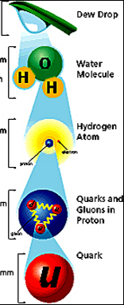
As scientists continued to study atomic theory, they discovered that the atom can be broken down into subatomic particles.
And those can be further broken down into elementary particles.
Elementary particles fall into two categories: quarks and leptons.

Slide 3
The Breakdown of the Atom
Atom
Proton
Neutron
Electron
Quarks
Up Quark
Down Quark
Strange Quark
Charm Quark
Top Quark
Bottom Quark
Subatomic Particles

Slide 4
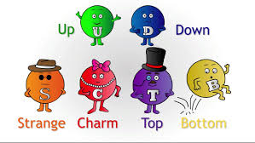
Quarks
Quarks are the smallest parts of a proton and a neutron.
There are six different types of quarks.
Each of these types of quarks has slightly different properties.

Slide 5
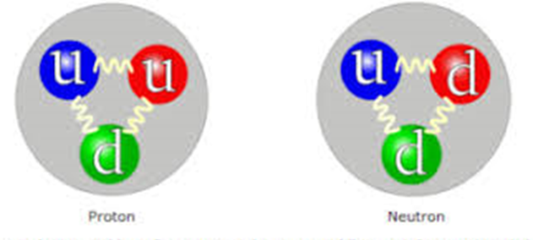
However, in general both a proton and a neutron are made up of three quarks.
The difference is that a proton is made up of two up quarks and one down quark, and a neutron is made up of one up quark and two down quarks.

Slide 6
Protons and neutrons, however, can get far more complicated!
They will always have these three quarks, but they can have far more complicated structures with extra strange quarks, charm quarks, top quarks, or bottom quarks as well.

Slide 7
Leptons
Unlike protons and neutrons, electrons are elementary particles.
They are a type of elementary particle called leptons. Leptons have six different types with their own different properties.

Slide 9
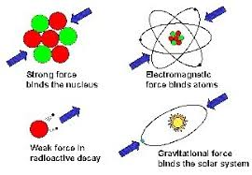
The Standard Model
Quarks and leptons are all part of the Standard Model of Particle Physics. The Standard Model also has four fundamental forces: gravity, electromagnetic, strong, and weak.

Slide 10
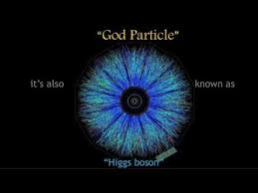
Bosons
Each of these forces are created by the exchange of a specific type of boson between different objects.
Until 2012, scientists had found all the bosons except for the Higgs boson.

