Slide 1
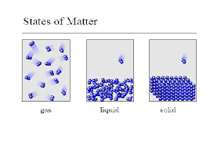
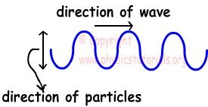
Big Idea Energy can be transferred as both a particle and a wave.

Slide 2
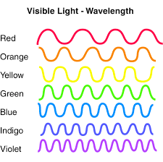
Waves

Slide 3
What Are Waves?
All waves are movements that transfer energy through matter or space.
Ocean waves= transfer energy through water.
Sound waves= transfer energy through air.

Slide 4
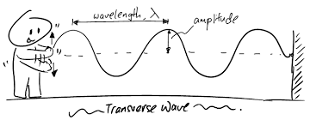
Two Types of Waves
Transverse Waves
Matter moves up and down perpendicular to how the wave travels
Compression Waves
Mater moves back and forth in the same directions as the wave travels

Slide 5
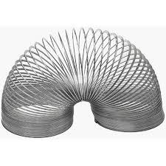
Demo

