Slide 1
Mass Wasting:

Slide 2
Types Of Mass Wasting:
Landslides or slope movements can be classified in many ways…
There are many attributes used as criteria for identification and classification including:
#1 - Rate of movement
#2 - Type of material
#3 - Nature of movement

Slide 3
Some Common Types Of Mass Wasting:
Three distinct physical events occur during a landslide:
the initial slope failure,
the subsequent transport,
and the final deposition of the slide materials.
Creep
Flow
Torrent
Avalanche
Slump
Slide
Fall

Slide 4
Factors which
Contribute to
Mass Wasting:

Slide 5
Many factors contribute to the instability of slopes, but the general controlling factors are:
The nature of the soil or material in question
The nature of the underlying bedrock
The configuration of the slope, vegetation etc.
The geometry of the slope, angle etc.
Groundwater or local fluid conditions

Slide 6
Undercutting of a slope by stream erosion, wave action, glaciers, or human activity such as road building,
Intense or prolonged rainfall, rapid snowmelt, or sharp fluctuations in ground-water levels,
Shocks or vibrations caused by earthquakes or construction activity,
Loading on upper slopes, or
A combination of these and other factors.

Slide 7
How Can We
Control
Mass Wasting:

Slide 8
METHOD OF CONTROL:
Protective Structures
Slope Modification
Reduce Slope Angle
Support Material @ Slope Base
Reduce weight on slope
Fluid Removal
Slope Stabilization
Retaining Walls
Coating Exposed Slopes
Steel bolts/Anchors
Vegetation

Slide 9
Protective Structures:

Slide 10
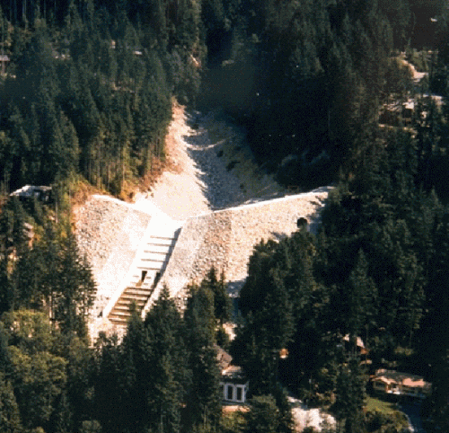
Harvey Creek Dam -
Preventing Debris Flow @ Lion's Bay!

Slide 11
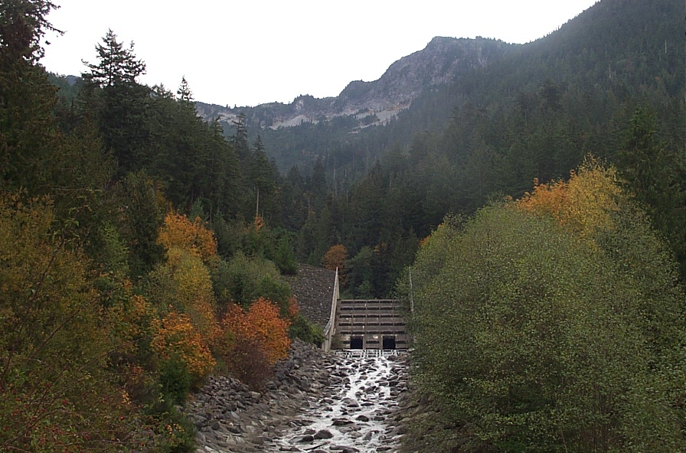
Same Thing - Different Angle!

Slide 12
Slope Modification:
Reduce Slope Angle
Support Material at Slope Base
Reduce weight on slope

Slide 13
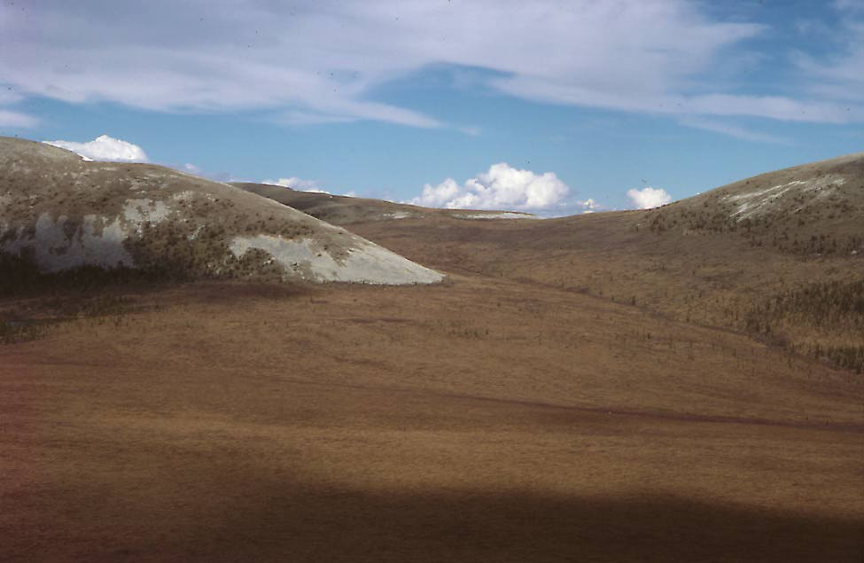
Reduce Slope Angle – the further below 38 degrees
(angle of repose)…the less likely a slide is!
25 Deg.

Slide 14
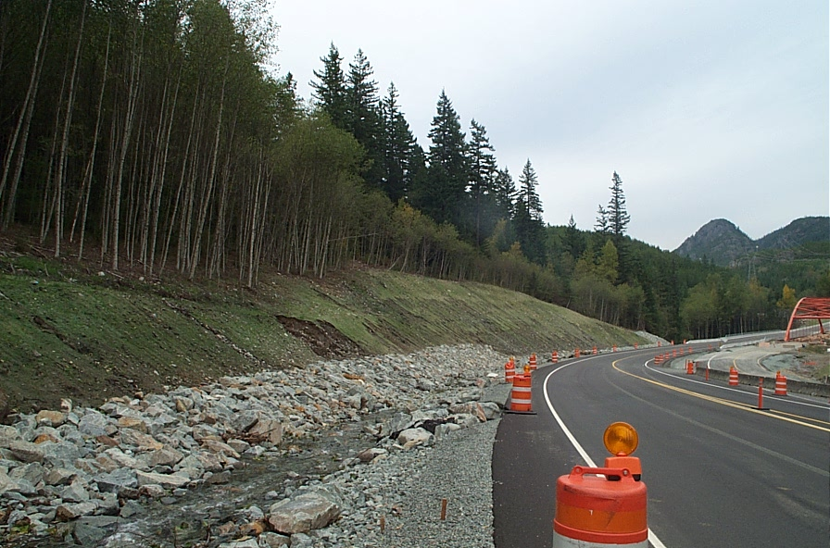
Support Material at Slope Base:

Slide 15
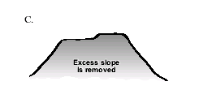
Reduce weight on slope

Slide 16
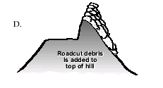
This Would Be
A Bad Idea:

Slide 17
Fluid Removal:

Slide 18
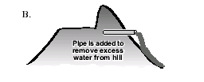

Slide 19
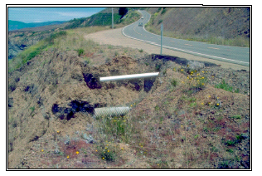

Slide 20
Slope Stabilization:
Retaining Walls
Coating Exposed Slopes
Steel bolts/Anchors
Vegetation

Slide 21
Retaining Walls

Slide 22
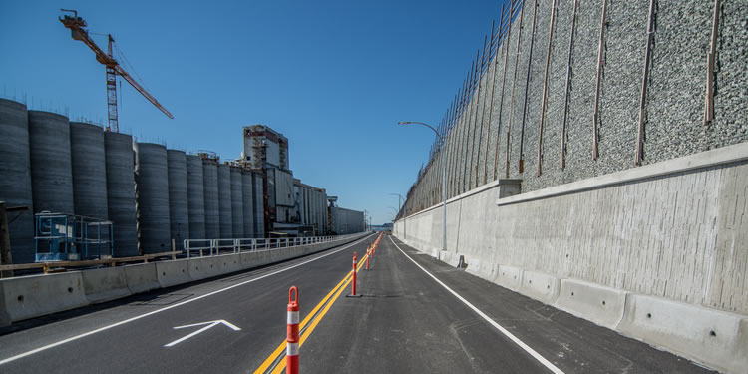

Slide 23
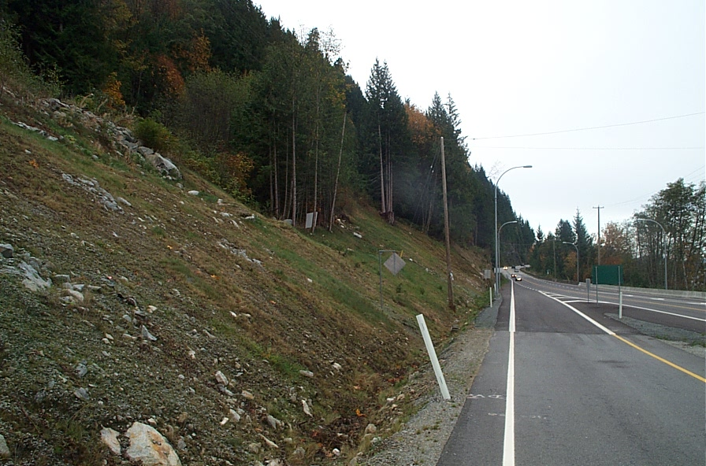
Coating or Covering Exposed Slopes

Slide 24
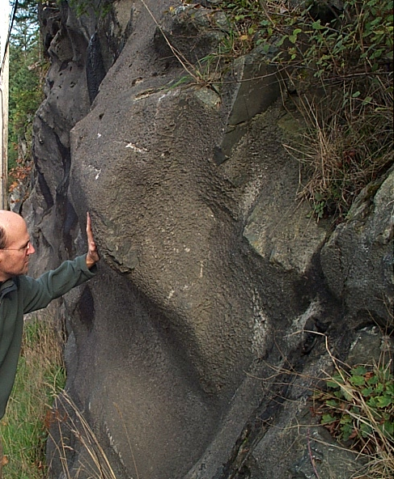
a spray on concrete type material!

Slide 25
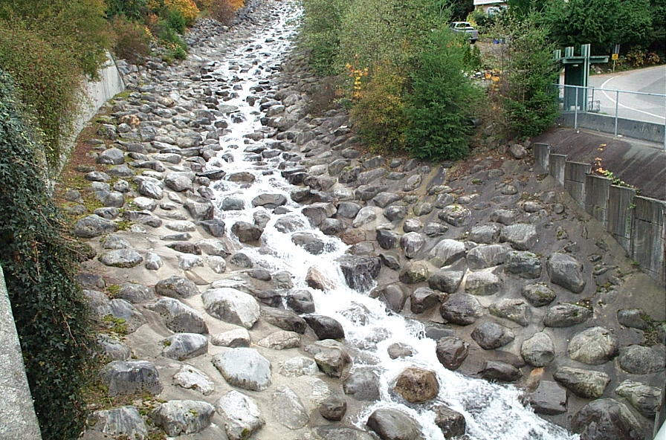
lining the creek beds with concrete or boulders
is common...

Slide 26
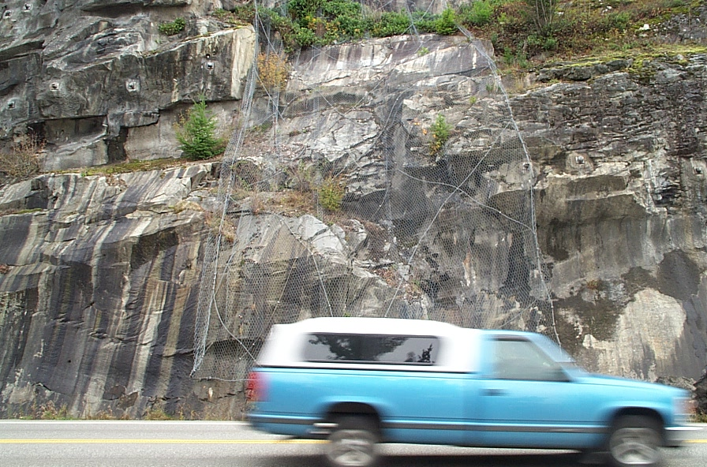
Nets are also a common "coating"

Slide 27
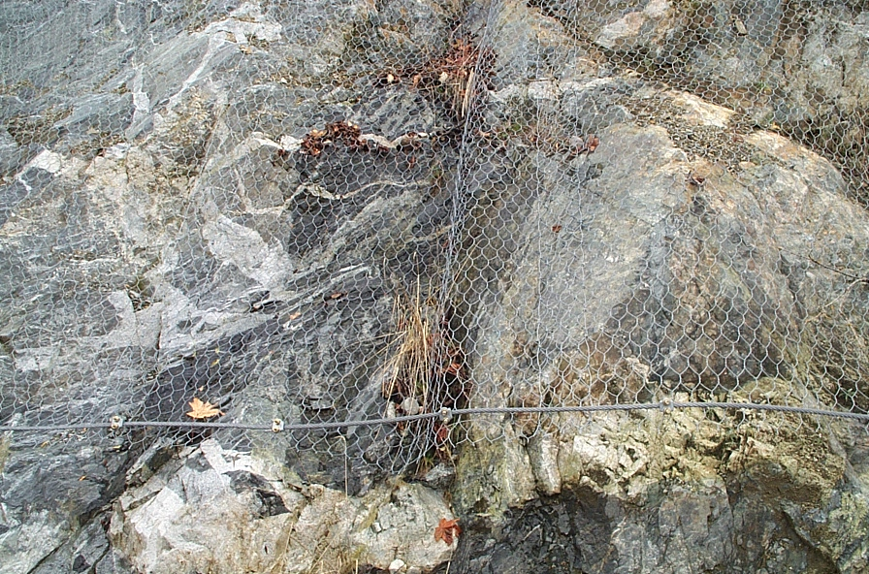

Slide 28
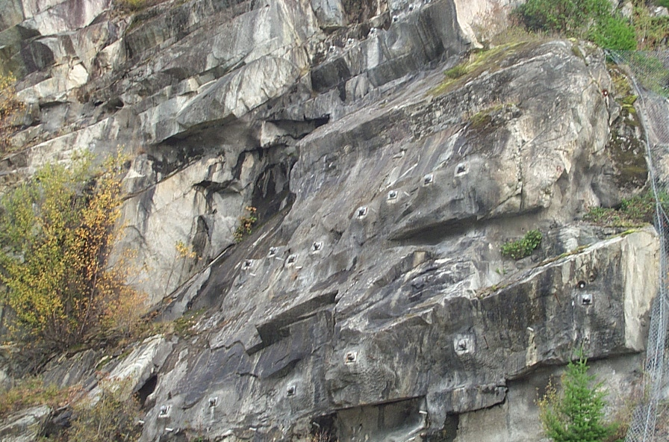
Steel bolts/Anchors

Slide 29
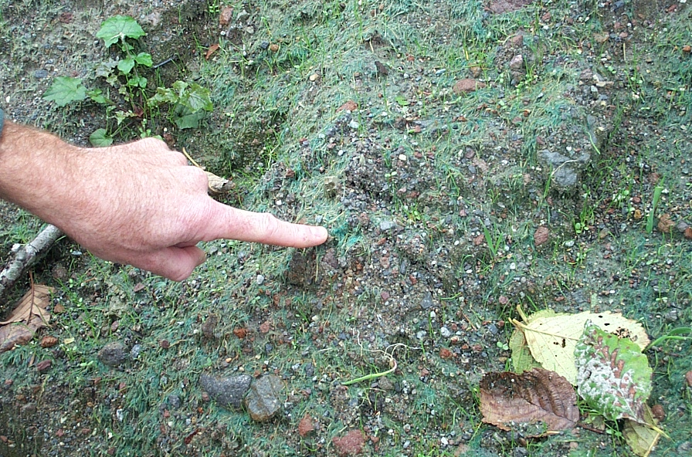
Vegetation

Slide 30
How Do Landslides
Effect Us?

Slide 31
The negative economic effects of landslides include:
The cost to repair structures - roads, dams, bridges, buildings, etc.
loss of property value,
disruption of transportation routes,
medical costs in the event of injury,
indirect costs such as - lost timber, fish stocks, and other resources,
Water availability, quantity and quality can be affected by landslides.
Geotechnical studies and engineering projects to assess and stabilize potentially dangerous sites can be costly.

Slide 32
Some Historical
Mass Wasting Events
In B.C.

Slide 33
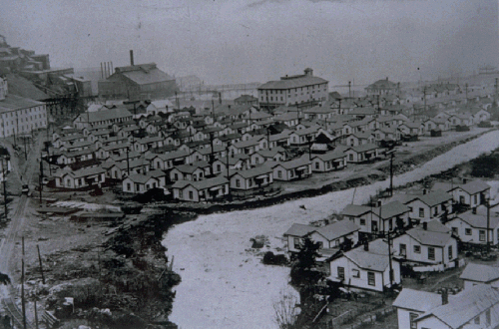
Brittania Beach:
Before debris flow of 1921

Slide 34
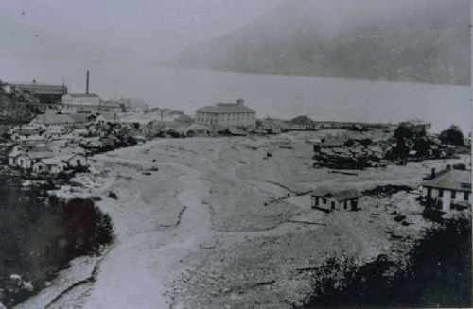
After flow!!

Slide 35
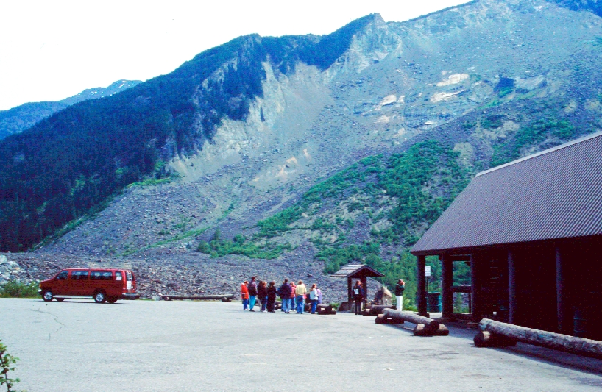
Hope Slide Now

Slide 36
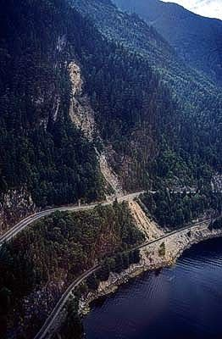
Logger's Creek, B.C. 1991 :
Failure is described as a medium-scale rockslide along the Squamish Highway, BC.
Cost $7 million for repairs and preventative structures
The slide closed both the highway and the B.C. Rail track for two weeks while clean up crews removed the debris.

Slide 37
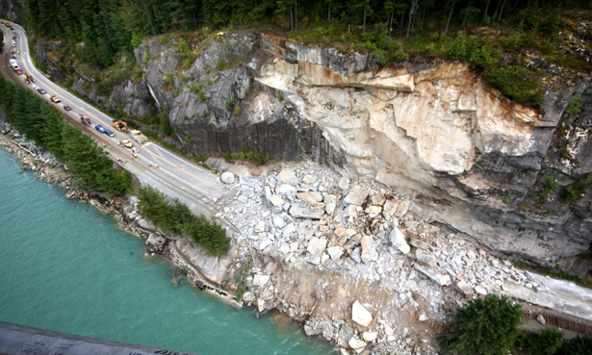
Sea to Sky rock fall
- Highway 99, B.C. 2008

