Slide 2
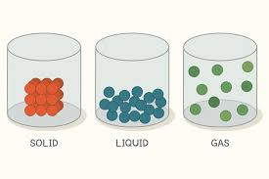
What is an atom made of?
An atom is defined as the smallest particle of an element, and it retains the properties of the element.
We already know that all matter is made of atoms, but what are atoms made of?

Slide 3
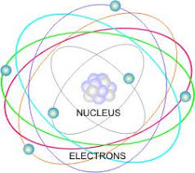
Atoms are made up of smaller particles called subatomic particles. These subatomic particles fall into two parts of the atom: the nucleus and the electron energy shell.

Slide 4
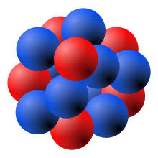
The Nucleus
The nucleus is the tiny region at the center of the atom
The nucleus contains protons and neutrons
The number of protons in a nucleus determines the charge of the nucleus and the identity of an atom.

Slide 5
The Electron Energy Shell
The area the electron moves in is 99.99% of the atom’s volume. This is the same as a toonie (the nucleus) in Rogers Arena (the electron shell)!
Electrons move around in specific regions called energy levels that surround the nucleus.

Slide 6
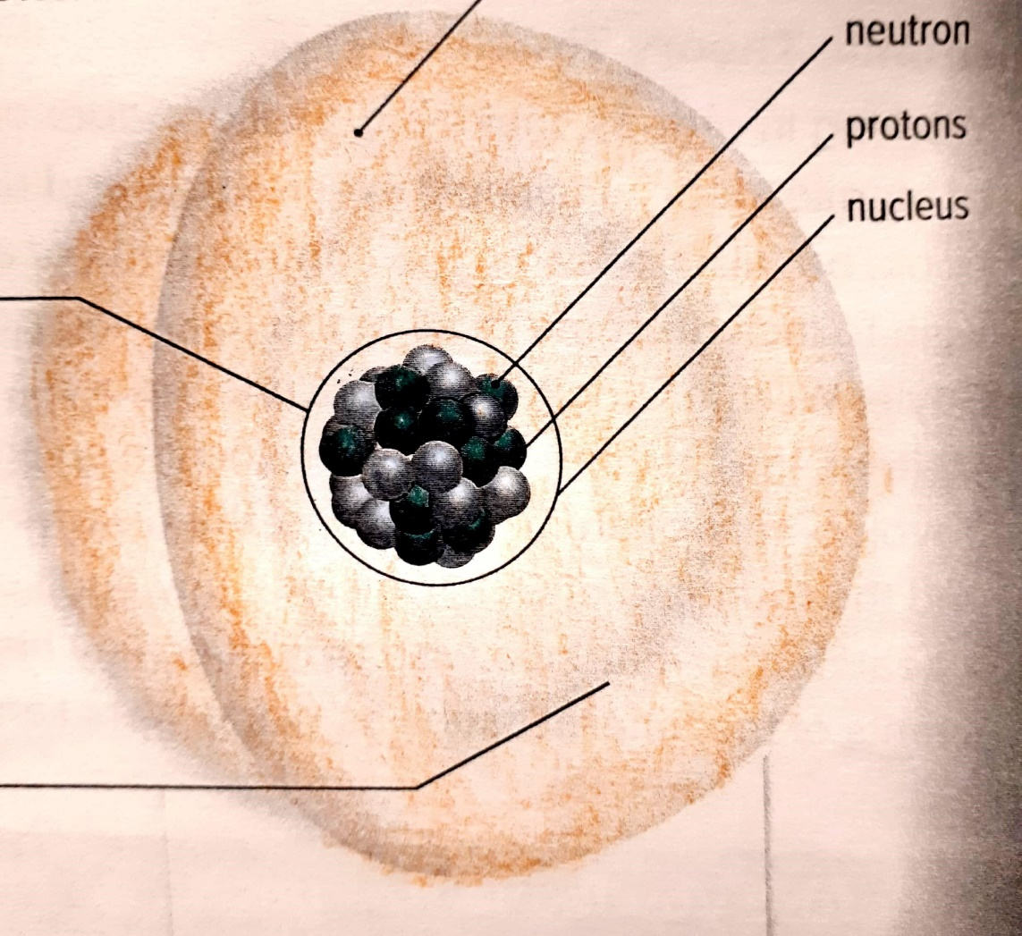
Electron shell containing electrons

Slide 7
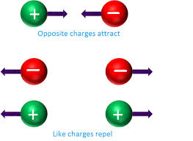
Electron Charge
Charge comes in two different types: positive and negative
Protons have a positive charge (1+) and electrons have a negative charge (1-).
Positive charge of the protons attracts the negative charge of the surrounding electrons.

Slide 8
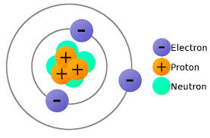
Neutrons have no charge.
Therefore, if there is the same number of protons and electrons, then the overall atom is neutral.

Slide 9
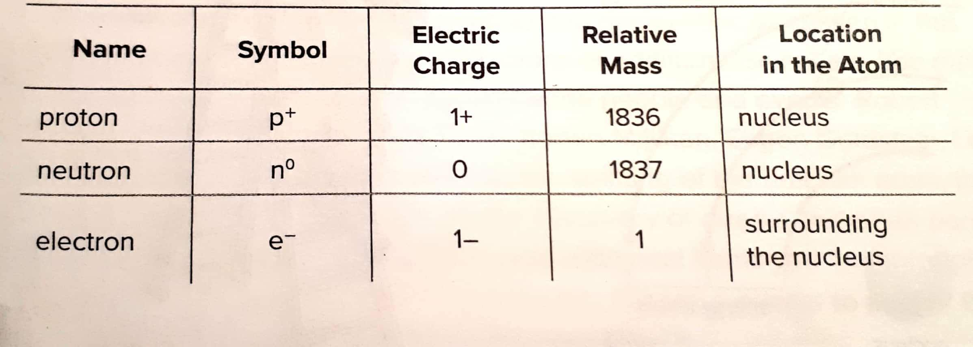
Subatomic Particles

Slide 10
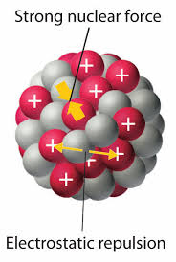
Nuclear Force
Normally charged particles will repel each other, if they have the same charge.
However, the nucleus has positively charged protons squished together.
They are held together in the nucleus by a force called nuclear force.

